Slide 1
SQL .PROJECT
SIDDHESH GUJAR

Slide 2
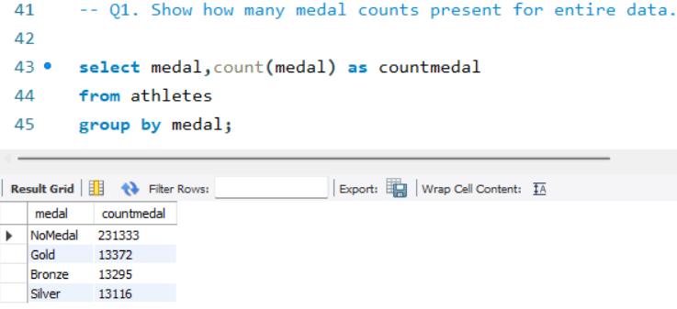
Q1. Show how many medal counts present for entire data.
Ans.

Slide 3
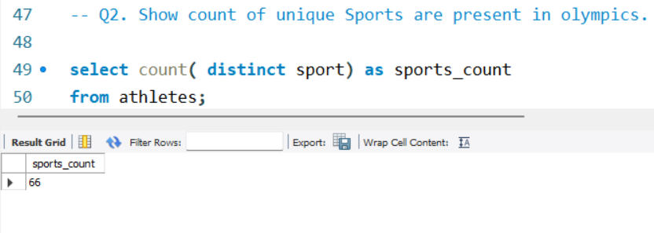
Q2. Show Count Of Unique Sports Are Present In Olympics.
Ans.

Slide 4
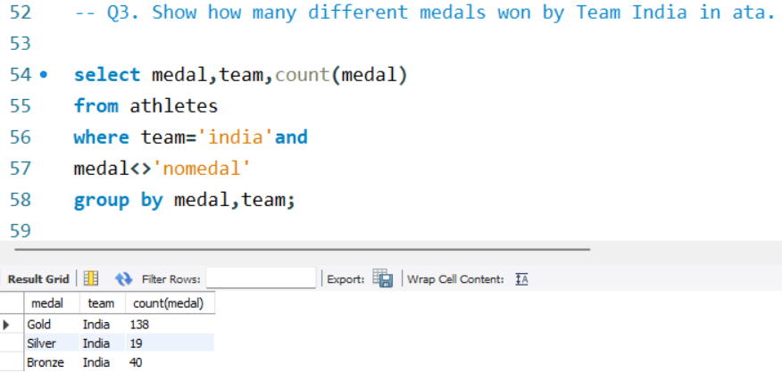
Q3. Show How Many Different Medals Won By Team India In Data.
Ans.

Slide 5
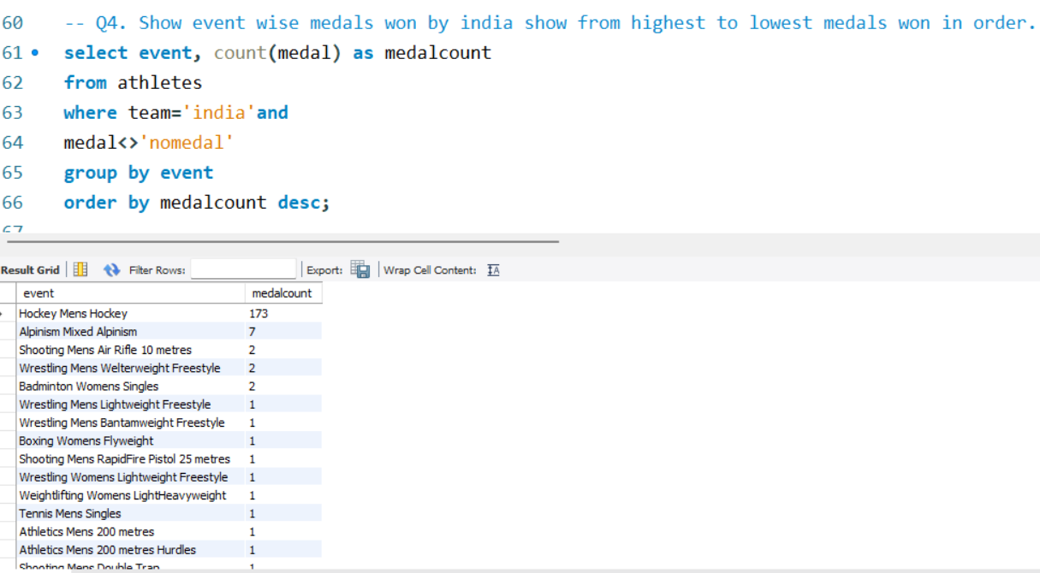
Q4. Show event wise medals won by India show from highest to lowest medals won in order.
Ans.

Slide 6
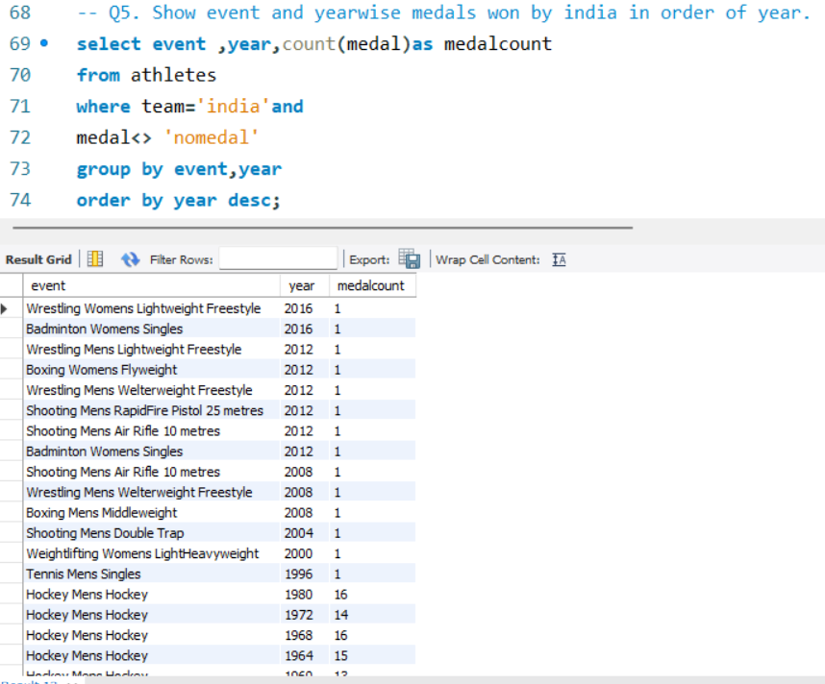
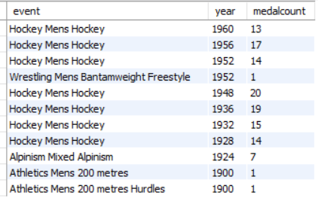
Q5. Show event and year wise medals won by India in order of year.
Ans.

Slide 7
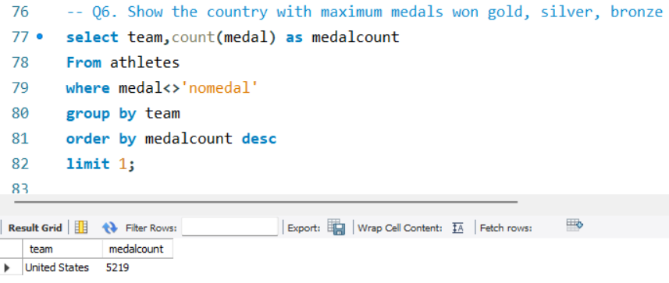
Q6. Show the country with maximum medals won gold, silver, bronze
Ans.

Slide 8
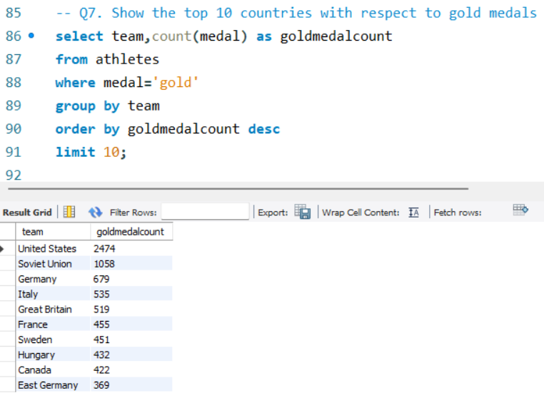
Q7. Show the top 10 countries with respect to gold medals
Ans.

Slide 9
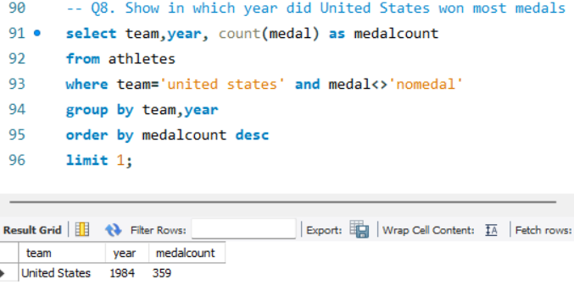
Q8. Show in which year did United States won most medals
Ans.

Slide 10
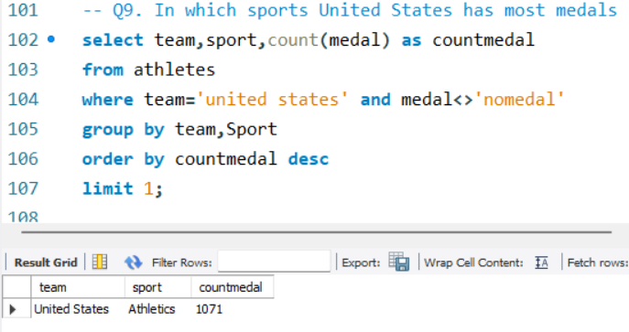
Q9. In which sports United States has most medals
Ans.

Slide 11
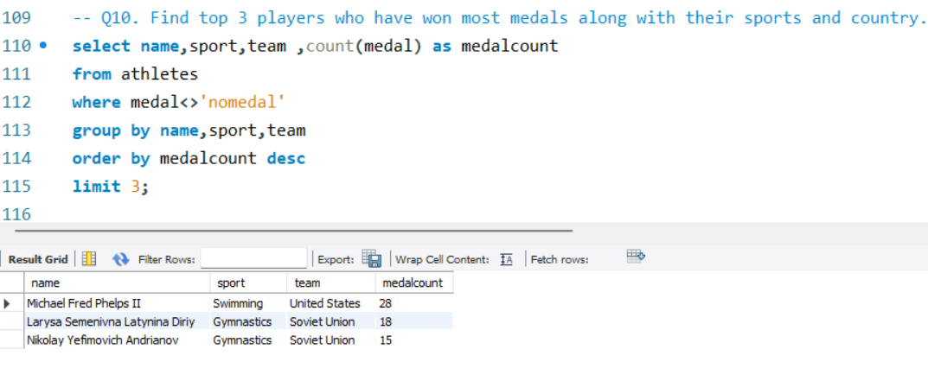
Q10. Find top 3 players who have won most medals along with their sports and country.
Ans.

Slide 12
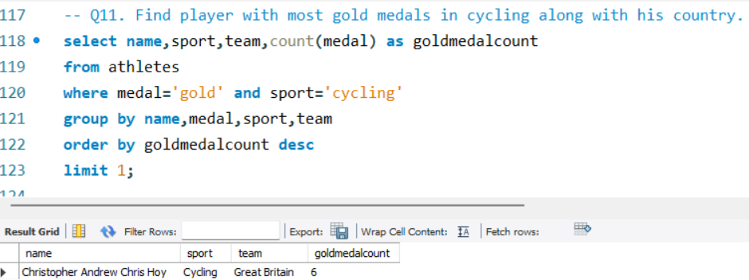
Q11. Find player with most gold medals in cycling along with his country.
Ans.

Slide 13
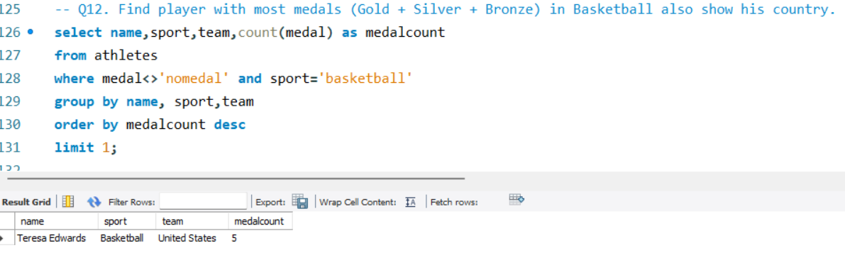
Q12. Find player with most medals (Gold + Silver + Bronze) in Basketball also show his country.
Ans.

Slide 14
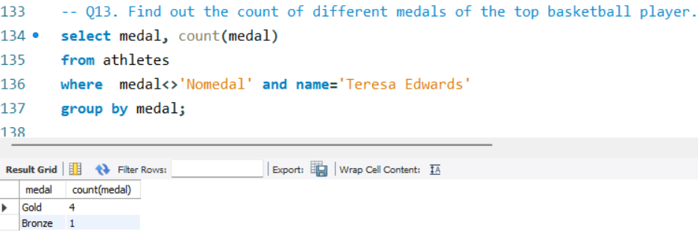
Q13. Find out the count of different medals of the top basketball player.
Ans.

Slide 15
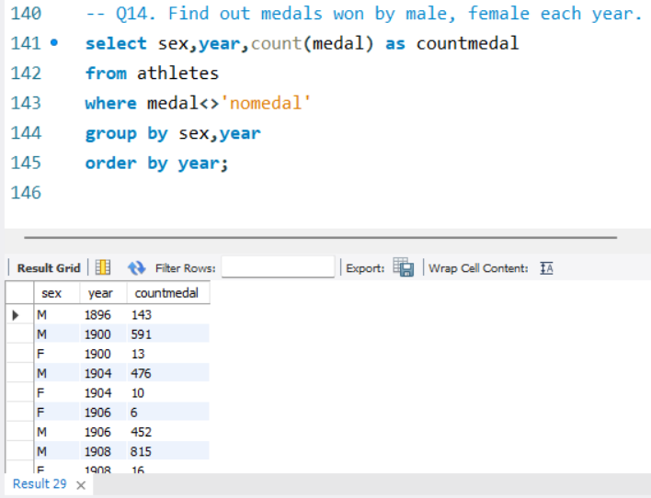
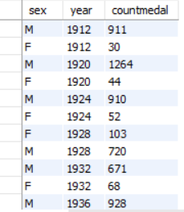
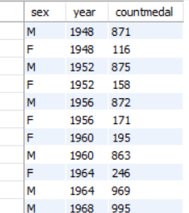
Q14. Find out medals won by male, female each year.
Ans.

